Slide 1
Cultural Humility Training
Module 1: Defining Cultural Humility
January 2026

Slide 2
Land Acknowledgement

Slide 3
Land Acknowledgement
I would like to acknowledge that we are situated on the traditional and ancestral lands of many Indigenous Nations on which we are learning, working and organizing today. The area known as Tkaronto has been taken care of by the Anishinaabe, including the Mississaugas of the Credit, Haudenosaunee, and Huron-Wendat territory. Today, this meeting place is still the home to many Indigenous Peoples from across Turtle Island and I am grateful to have the opportunity to work on this land as a settler.
References:
Truth and Reconciliation Commission of Canada: Calls to Action
Land Acknowledgement Guidance (toronto.ca)
Dish With One Spoon - Nandogikendan
Activism Skills: Land and Territory Acknowledgement - Amnesty International Canada

Slide 4
Placeholder for EAP Contact Information

Slide 5
Module 1: Defining Cultural Humility

Slide 6

What is Cultural Humility?
“In the medical context, cultural humility may be defined as a process of being aware of how people’s culture can impact their health behaviours and in turn using this awareness to cultivate sensitive approaches in treating patients.
- Prasad et. al. 2016
Notes:
I want to begin with this quote, which offers a concise but powerful definition of cultural humility in medical contexts.
READ QUOTE ON SLIDE: “In the medical context, cultural humility may be defined as a process of being aware of how people’s culture can impact their health behaviours and in turn using this awareness to cultivate sensitive approaches in treating patients”❞
It reminds us that cultural humility is not about memorizing facts about specific groups or aiming for perfect knowledge — it’s about process.
It starts with being aware that culture shapes how people understand and engage with health, care, and even systems like hospitals. From that awareness, we’re invited to adapt — to approach others with curiosity, sensitivity, and a willingness to learn.

Slide 7
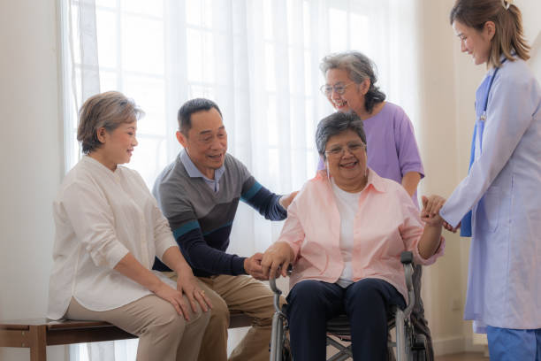


The Scope of Cultural Humility
Practiced through ongoing self-reflection, learning, and systems awareness
Applies across roles:
in care
Leadership
policy, and
systems development
Focuses on power dynamics, historical context, and relational awareness
Notes:
The scope of cultural humility and its practice is rather large because it challenges us to move away from assumptions, check our biases, and continually ask:
How might a patient’s experience — and my own positionality — shape what’s happening in this interaction?
But we can practice, support and learn from one another since cultural humility isn’t just for front-line providers. It extends to everyone involved in shaping healthcare — from administrators to front line staff. Whether we’re designing systems, crafting policies, or managing teams, we all have a role to play.

Slide 8
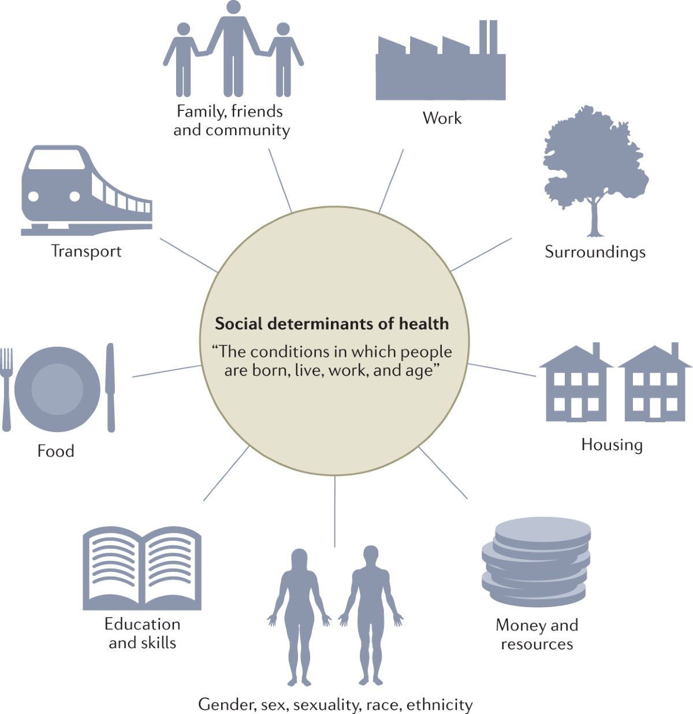
Social Determinants of Health
Health shaped by the social determinants of health (SDOH): factors like housing, education, income, employment, and access to care
Systemic oppression negatively influences SDOH
Addresses untrue belief that biological factors based on race influence health outcomes: Rather, oppression and poor health is due to factors external to equity deserving communities, not
factors inherent to them.
Digging Deeper: Health Inequities
Notes:
As seen in the Health Equity Training modules, this visual gives us a quick snapshot of what shapes health outcomes — from economic stability to education to community context. These are all interconnected and directly influence a person’s ability to access care, feel safe, and maintain wellbeing. We'll now take a deeper look at how this plays out here in Canada.
While some might assume that health inequities are minimal in a country like Canada with universal healthcare, there is conclusive evidence that health access and quality outcomes are not equally distributed across the population and that health broadly defined - are shaped by far more than just clinical care — they’re shaped by the conditions in which people live, work, learn, and age.
Taken together, as we discussed in the health equity training, these are known as the social determinants of health (SDoH), and they include things like housing, education, income, employment, and access to care. They extend beyond personal circumstances because they are shaped by systemic inequities and the constraints those have on individual choices.
For example, while basic medical services may be covered, many people still struggle to afford prescriptions, dental care, or mental health services. If someone is unemployed or retired, they may have limited or no extended coverage. If someone lives in a remote or rural area, the nearest specialist might be hours away.
Racialized communities, people with disabilities, 2SLGBTQ+ folks, and those living at the varying intersections of marginalized identity often experience care that is inaccessible, biased, or not culturally safe.
And much like identity itself, the social determinants of health operate simultaneously AND across different levels:
• Macro (e.g. how and where care facilities are built)
• Meso (e.g. in definitions of who is eligible for care and what forms of care are ‘recognized’)
• Micro (e.g. whose pain is ‘valid’ and how symptoms are observed/understood)
So when we talk about health equity, we’re not just talking about closing gaps in care — we’re talking about challenging the structures that produce and maintain those gaps.

Slide 9
Why Cultural Humility Matters
Cultural humility is a response to health inequities
It bridges the gap between knowing about injustice and unfairness and acting in ways that disrupt these patterns
Fosters trust, safety, and respect in clinical and care interactions
Encourages accountability to those historically marginalized by the system
Notes:
Cultural humility is more than just a concept — it is both a response and a practice.
It’s what fosters trust, especially in health and social care settings where people have been historically mistreated or dismissed. And it reminds us that accountability isn’t just about apology — it’s about doing better, consistently, for those who’ve been pushed to the margins.

Slide 10
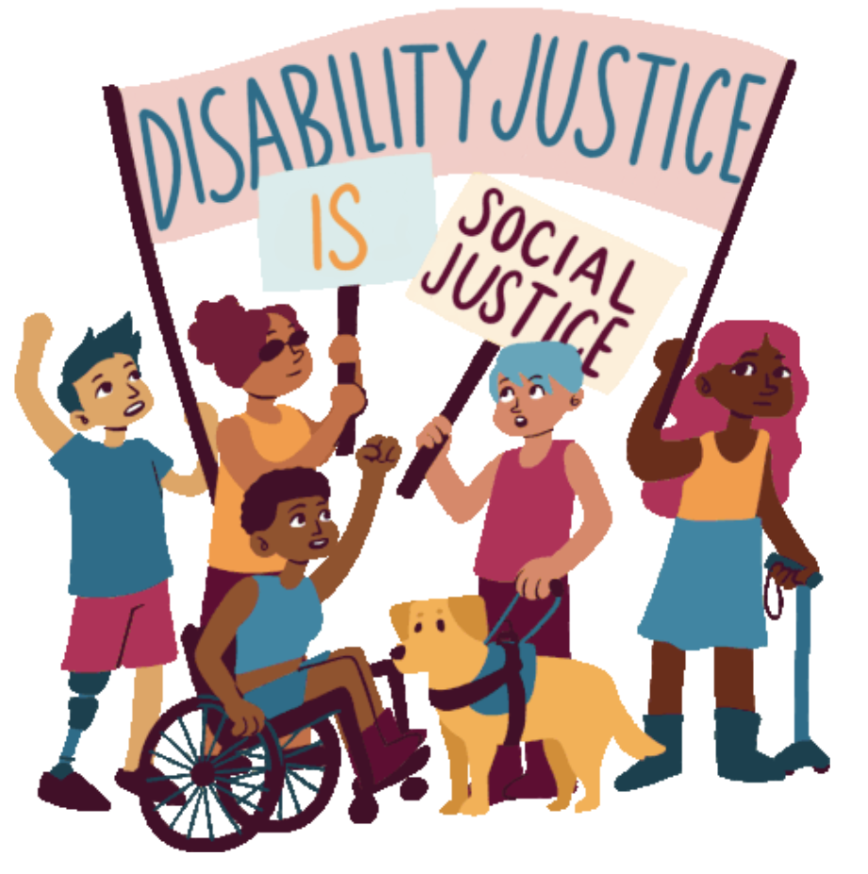
Connecting Cultural Humility and Disability Justice
Disability justice recognizes the intersecting legacies of white supremacy, colonial capitalism, gendered oppression and ableism in understanding how people's’ bodies and minds are labelled ‘deviant’, 'unproductive’, ‘disposable’ and/or ‘invalid’.
Notes:
Read definition quote on slide and then speak to the origins: "The term disability justice was coined out of conversations between disabled queer women of color activists in 2005, including Patty Berne of Sins Invalid (and Mia Mingus & Stacy Milbern, who eventually united with Leroy Moore, Eli Clare, and Sebastian Margaret) seeking to challenge radical and progressive movements to more fully address ableism." https://projectlets.org/disability-justice

Slide 11
Continued - Connecting Cultural Humility and Disability Justice
Both cultural humility and disability justice challenge the false belief of “neutral” systems
Oppression — not just individual prejudice or behaviours — drive exclusion and inequity
Centering lived experience, relationships, and access reshapes how we design care
Calls us to act in solidarity, rethink policy and practice, and build equity into our systems
Notes:
Cultural humility and disability justice are deeply aligned — both challenge the idea that our systems are neutral or universally accessible. In reality, many structures in healthcare and beyond were not designed with equity-deserving communities in mind.
That is, even when exclusion isn’t malicious or the result of overt prejudice — it still appears in the form of structural bias built into the norms, policies, and practices we rarely question.
By centering lived experience, relationships, and collective access, cultural humility and disability justice offer us new ways to think about care — not just as a service, but as a relationship we form with patients, and one another, that is grounded in equity.
As we close out this section, let’s shift our focus from defining cultural humility to exploring how it can be practiced — alongside anti-racism and anti-oppression — in real-world care and workplace settings.

Slide 12
Thank You

