Slide 1
Health Equity Training Module 3:
Deconstructing Oppressive Structures and Systems
January 2026

Slide 2
Land Acknowledgement

Slide 3
Land Acknowledgement
I would like to acknowledge that we are situated on the traditional and ancestral lands of many Indigenous Nations on which we are learning, working and organizing today. The area known as Tkaronto has been taken care of by the Anishinaabe, including the Mississaugas of the Credit, Haudenosaunee, and Huron-Wendat territory. Today, this meeting place is still the home to many Indigenous Peoples from across Turtle Island and I am grateful to have the opportunity to work on this land as a settler.
References:
Truth and Reconciliation Commission of Canada: Calls to Action
Land Acknowledgement Guidance (toronto.ca)
Dish With One Spoon - Nandogikendan
Activism Skills: Land and Territory Acknowledgement - Amnesty International Canada

Slide 4
Placeholder for EAP Contact Information

Slide 5
Module 3: Deconstructing Oppressive
Structures and Systems

Slide 6


An Example - Housing
Systemic
Insufficient accountability + funding across all levels of government for decades
Lack of investment to address homelessness
Housing that does not meet diverse needs, for example: accessibility, lack of access to community assets in marginalized communities
Note:
Often used interchangeably, here systemic vs. institutional is broken down here in relation to how it functions in organizations
Institutional
Restrictive access to affordable housing for example: TCHC banning households for an individual engaged in alleged illegal act
Minimum income criteria
Discriminatory mortgage providers
Interconnected relationship with different levels reinforcing and/or enabling one another
Interpersonal
Landlords who renovict, misuse N5s etc.
Discrimination in application processes and/or outright refusal
Notes:
Module 1 introduced us to how discrimination operates at systemic, institutional and interpersonal levels; as well as figures demonstrating the impact of discrimination on well-being; and how we are affected by the SDOHs
Module 2 delves into a history of entrenched racism, colonization, medical racism, and touches on how this history extends to our present
Module 3 will deeply unpack:
How oppression operates across systems, institutions and interpersonal experiences impact our lives.
We will then apply this lens to a scenario to deepen recognition
For this slide, it could be broken down to look at employment, the criminal justice system, education, etc. We will analyze the example of housing.
Housing is often cited as one of the most important SDOHs and a lack of housing directly correlates with poor health outcomes. It is also more difficult for a person with unstable housing to access healthcare.
This slide is not an exhaustive breakdown of how discrimination operates but to help illuminate how discrimination is interlocking and compounding at the different levels displayed here
Systemic Gaps:
Insufficient accountability + funding in across levels of gov for decades
Low investment addressing homelessness , disproportionately impacts equity deserving communities
Housing that does not meet diverse needs, ex: accessibility, unresponsive to multi generational families, left unrepaired, lack of access to community assets in marginalized communities
Institutional Gaps:
Restrictive access to affordable housing for example, TCHC banning households for an individual engaged in alleged illegal act
Minimum income criteria by housing providers
Mortgage providers known to discriminate against racialized prospective owners
Reference:
The Green Line, “Why Toronto is in a Housing ‘State of Emergency’ – And Who’s Affected Most”: Why Toronto is in a housing 'state of emergency' — and who's affected most - The Green Line

Slide 7
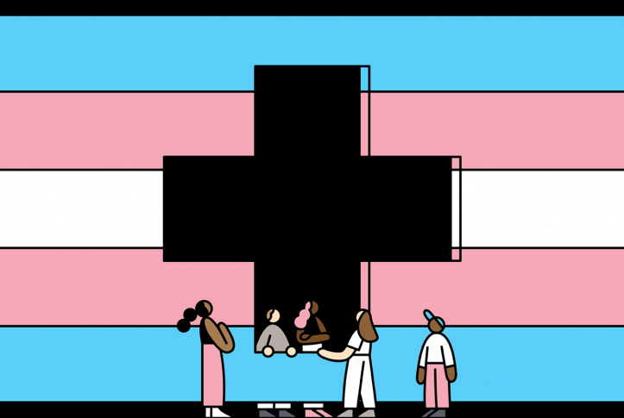
Breakout Activity: Scenario Discussion
A trans man must travel 1+ hour to access limited gender-affirming care.
His family doctor from childhood is dismissive and often misgenders him.
The doctor says he is uncomfortable prescribing hormones and seems
uninterested in understanding trans health. The patient comes from a
family with exclusionary beliefs about trans people, and the family is
friends with the doctor. The patient is concerned the doctor will share
information he is not yet comfortable discussing with family.
The patient has contacted trans-specific clinics for support and had an introductory phone call. He has also been told waitlists for gender-affirming surgery can be months to years long, and can be delayed further if the patient is sick. The patient also does not have sick days from his employer. The patient is required to travel to get blood work before his first gender-affirming care appointment, which takes significant time on transit in his region. The patient is anxious to protect his minimal income and maintain baseline health for all future gender-affirming care needs.
Notes:
Review the scenario individually or as a group
Break out into small groups identifying how discrimination is operating:
Systemically,
Institutionally, and
Interpersonally
~20 minutes

Slide 8
Breakout Activity: Scenario Discussion
In your breakout group, spend ~20 minutes exploring how the following dynamics are surfacing in the case scenario:
    Interpersonal discrimination
    Institutional discrimination and inequities
    Systemic discrimination and inequities
    Microaggressions
Notes:
Give groups an opportunity to connect and define how discrimination at the different levels shows up in the scenario
Discuss how these experiences can dehumanize and cause harm, contribute to poorer health outcomes and mental distress, and have the potential to deter future accessing care

Slide 9
Examples
Interpersonal discrimination
  Misgendering, alienating attitudes towards masking
Institutional discrimination and inequities
  Significant wait times, many steps to access care, insufficient public health protocols
Systemic discrimination and inequities
  Lack of paid sick days, lack of accessible gender affirming care (including geographical disparities), transphobia across society, inadequate transit
Microaggressions
  Exclusion based on gender, doctor uncomfortable discussing hormones
Notes:
Present some of the examples and interconnectedness of the oppression and invite if folks discussed other examples

Slide 10
Strategies at the Individual Level
Challenging internalized oppression requires self-awareness on how our identities and experiences shape our interpersonal interactions
Discomfort in this work is inevitable — shows up as silence, defensiveness, guilt, fear of saying the wrong thing, withdrawal
Recognize our potential for growth, change, and accountability when we sit with discomfort
When conversations about race, harm, or privilege feel uncomfortable, what is your typical reaction? What do you think that reaction protects you from confronting?
Notes:
The scenario helps us explore the complexity of health inequities and the way that systemic oppression, barriers and discrimination permeate our lives, and shape the realities of institutions and personal interactions.
The eradication of systemic oppression must happen at the level of systems, and we can also be accountable for better and more equitable care as individuals, as teams, and advocates championing systemic change.
Systems are not inanimate - humans operate and uphold systems. At the individual level, we must challenge our internalized oppression This requires self-awareness on how our identities and experiences shape our views and behaviours as a result of being socialized in the oppressive systems we live in. We will dig more deeply into these strategies in the cultural humility training.
Discomfort in this work is inevitable. It shows up as silence, defensiveness, guilt, fear of saying the wrong thing—sometimes even withdrawal. These reactions aren’t random. They come from somewhere—often from how we were socialized, or from legacy cultures that taught us not to talk about power or harm.
This self-reflection question is not about blame. It’s about understanding your own response patterns—and recognizing what those patterns protect. Reflection like this helps us shift from judgment to curiosity, and from defensiveness to growth - both of which better serve patients seeking care.
We will further discuss strategies for meaningful reflection and intervention in the Cultural Humility modules.

Slide 11
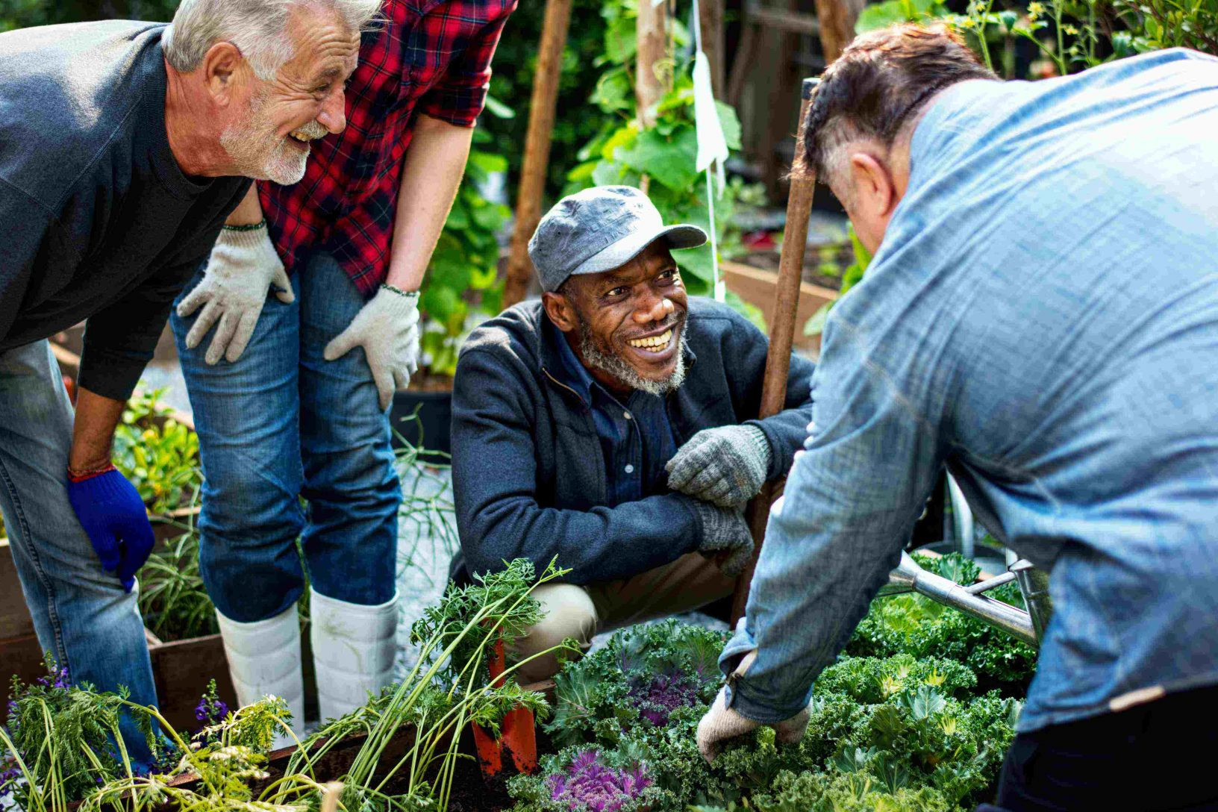
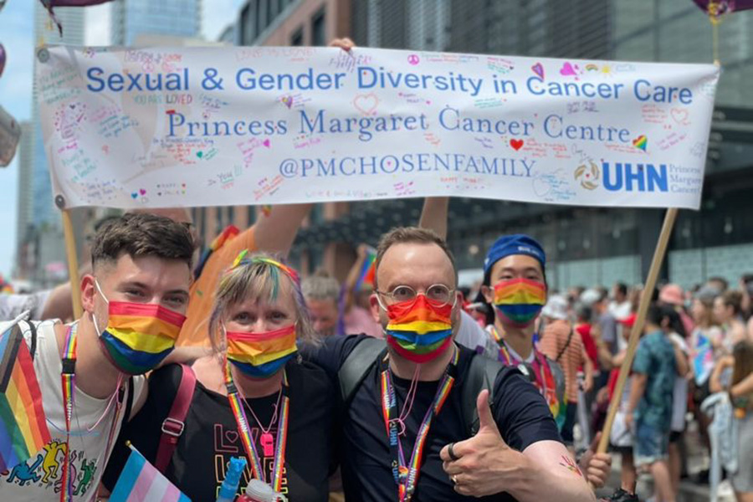
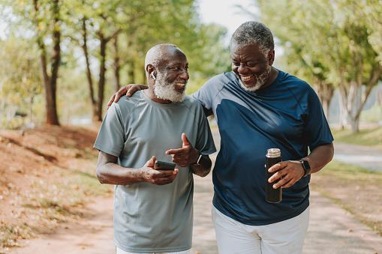
Beyond Individual Strategies for Lasting Change
Uprooting systems creating health inequities, systems buttressed by centuries of racism and colonization, will not happen overnight. Luckily, many programs and innovations exist meeting communities where they are, culturally responsive, and embedding principles of Anti-Racism /Anti-Oppression that we can expand and spread, such as:
Community Ambassador Model
Gender Diversity Rounds
Black Social Prescribing
Notes:
Undoing and systems change is long, intergenerational work
In addition to personal strategies, we must connect across teams and organizations, advocate, innovate, scale solutions, and learn from what's happening in community and across systems
Community-led, culturally responsive work is already happening. Be inspired by what exists, spread where possible, build on the momentum working in close partnership with community and experts to leverage evidence based models
Community ambassador model
Gender Diversity Rounds (COP to enhance gender affirming care)
Black social prescribing

Slide 12
Thank You

