Slide 1
Health Equity Training Module 1: Key Concepts
January 2026

Slide 2
Land Acknowledgement

Slide 3
Land Acknowledgement
I would like to acknowledge that we are situated on the traditional and ancestral lands of many Indigenous Nations on which we are learning, working and organizing today. The area known as Tkaronto has been taken care of by the Anishinaabe, including the Mississaugas of the Credit, Haudenosaunee, and Huron-Wendat territory. Today, this meeting place is still the home to many Indigenous Peoples from across Turtle Island and I am grateful to have the opportunity to work on this land as a settler.
References:
Truth and Reconciliation Commission of Canada: Calls to Action
Land Acknowledgement Guidance (toronto.ca)
Dish With One Spoon - Nandogikendan
Activism Skills: Land and Territory Acknowledgement - Amnesty International Canada

Slide 4
Placeholder for EAP Contact Information

Slide 5
Module1: Exploring Key Concepts

Slide 6

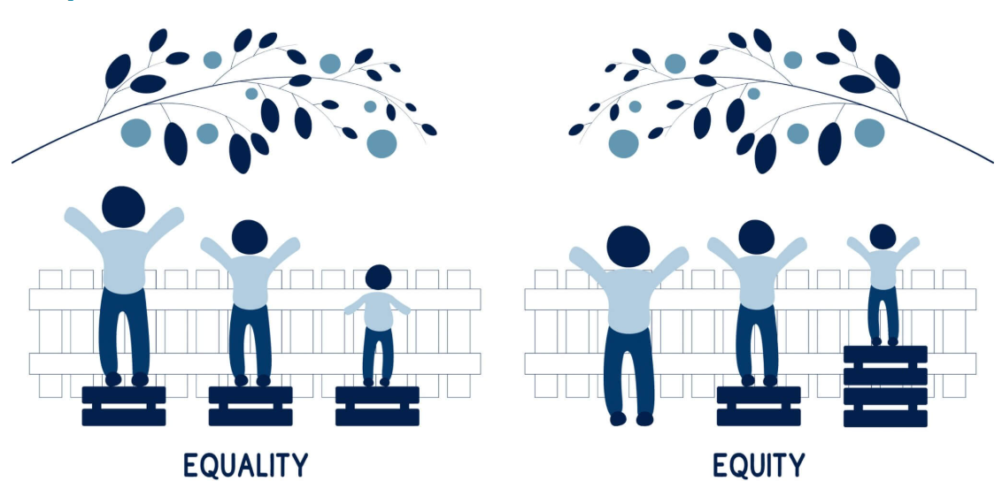
Overview of Key Concepts
Health Equity
is the fair distribution and access to resources needed for health and
well-being.
Pursuit of health equity requires eradicating health inequities (disparities in health access, experiences, and outcomes) through removing the burden of ill health caused by social and economic oppression and disadvantage.
Source: NCCDH. Ontario Health, National Collaborating Centre for Infectious Diseases
Notes:
Outline slide key definitions and the relationship between them

Slide 7
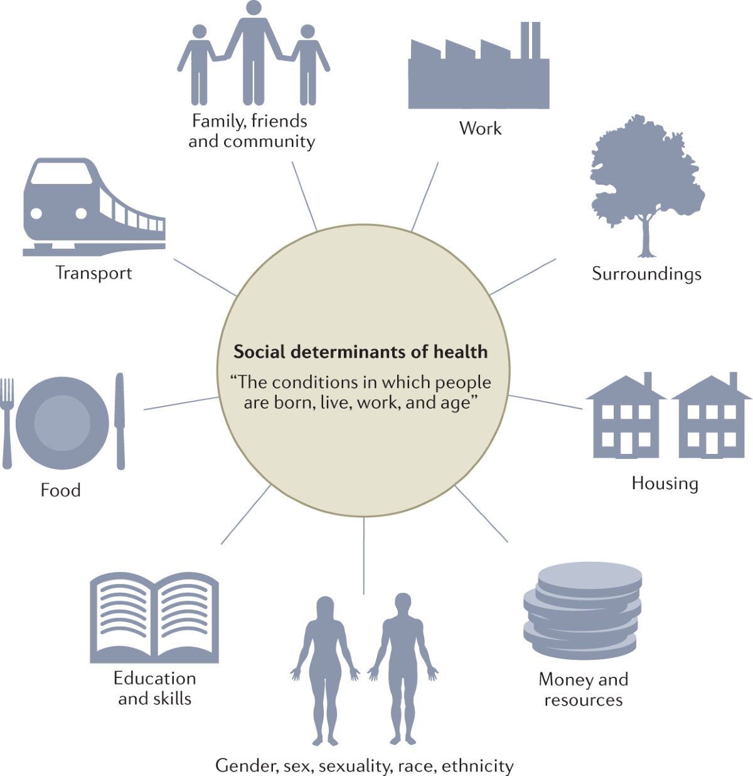
Social Determinants of Health
Health shaped by the social determinants of health (SDOH): factors like housing, education, income, employment, and access to care
Systemic oppression negatively influences SDOH
Addresses untrue belief that biological factors based on race influence health outcomes: Rather, oppression and poor health is due to factors external to equity deserving communities, not factors inherent to them.
Digging Deeper: Health Inequities
Notes:
Accessible and relevant healthcare is one determinant of our overall well-being, which is also shaped by the social determinants of health, interconnected factors that include employment, education, housing, geography, social and cultural connection, experiences of oppression, etc.
This framework in particular includes elements of identity, such as gender, race, and sexuality. Not all frameworks encourage you to think about the enhanced safety and affirmation of considering and responding to one’s cultural practices, gender identity, etc.
Inequitable access to these factors and the systemic discrimination we may experience - transphobia, homophobia, ableism, poverty, xenophobia, racism and other forms of oppression - can shape our well-being. Oppression creates barriers to access safe and suitable housing, higher education, quality and sufficient food, etc. that would support an individual or community’s health.
Frequently, systems and leaders have overlooked systems of oppression to suggest deficits or differences exist inherent to equity deserving communities.
A telling framing by an American Sociologist and Professor: “...the diabolical genius of making this political system seem biological is that the very unequal conditions it produces become an excuse for racial injustice.” – Dorothy Roberts, Fatal Invention, 2011
The pandemic highlighted for us the inequities that exist within the Toronto community, that which can prevent for some and allow access for others. It is these inequities that presented opportunities such as providing vaccine outreach and meeting people where they’re at to either eliminate or minimize the impact and inconvenience related to the SDoH. As healthcare professionals, we should be thinking about supporting access to fulfill the needs of clients and patients to ultimately find more collaborative and holistic opportunities and upstream approaches to address the SDoH

Slide 8
Digging Deeper: Health Inequities
Systemic Oppression
Manifests in Institutions
Reinforced by Individuals
Systems shaped by colonialism, racism, homophobia, transphobia, and structural poverty:
Ex. Discriminatory immigration policies, lack of affordable housing, incarceration of Black & Indigenous populations.
Oppressive systems and ideologies influence the design of institutional policies and practices:
Ex. System planning and service offerings that overlook underserved populations.
Perpetuated through attitudes and individual decisions by care providers:
Ex. Everyday discrimination that undercuts, dismisses, or minimizes equity deserving populations (intentional or not).
Informs decision making + cycles of harm
Shape values + attitudes at individual levels
Interconnected factors in
both past and present & our failure to invest in
eradicating them.
Informs decisions on resource distribution: which issues are priority & what “cannot be helped”
Compounding experiences of humiliation/harm leads to folks not seeking care
Notes:
Define systemic, institutional and interpersonal forms of oppression and how they cause/advance health inequities.
Note: institutional and systemic oppression are sometimes spoken about interchangeably. In this context we are describing specifically how it manifests in systems, as in ideologies and policies, vs an institution, such as a hospital.
Systemic
Speak to how discrimination in incarceration, housing, immigration policies (current and past) etc. is informed by systemic racism, economic oppression, etc.
Outline how lack of investment and effort in confronting these systems is also part of oppression. Systemic oppression is both policies and ideologies that perpetuate discrimination and a lack of care/investment in addressing and naming disproportionate harm (ex: ignoring + insufficient action on homelessness, opioid crisis, etc.)
Institution
Policies and practices in institutions cascade from these systemic ideologies and policies, reproducing discrimination that exists more broadly, ex: funding, program design, access
Interpersonal
Interactions and everyday discrimination that undercuts, dismisses, or minimizes equity deserving pops. Even if not intentionally harmful, has major impacts on health outcomes. Leaving these groups untreated, harmed, and potentially unlikely to return.
How discrimination manifests such as: being unable to diagnose conditions (ex: measles) on darker skin, assumptions that communities are drug seeking, failing to recognize trans folks or refusing to prescribe hormones, perpetuating limited notions of what “healthy” looks like, ex: assuming fat people are inherently unhealthy + missing their broader experiences
A scenario that speaks to oppression across these categories: Sickle Cell Disease (SCD)
There is now a provincial standard for SCD care. One of the foremost problems individuals with SCD named in accessing care is the anti-Black racism they experience. The way they have been regarded by practitioners as “drug seeking”, and their pain not taken seriously upon presentation in the ED. SCD patients frequently do not receive what is deemed best practice standard of care to alleviate pain (which is often described as a sharp, intense, stabbing or throbbing pain occurring in various parts of the body, including bones, chest, abdomen, and joints), due to lack of knowledge, training and standardized processes. At the systemic level, there is a lack of funding institutions, and investment in further understanding and treating this condition through in research and other means. Individuals with sickle cell also noted the drastically different level of care they received as children vs as adults. No longer treated as though their lives are precious, and treated with skepticism or dismissal as adults. All of this further projecting colonial and racist ideology that dismisses Black pain, and treat Black people with suspicion, etc.

Slide 9





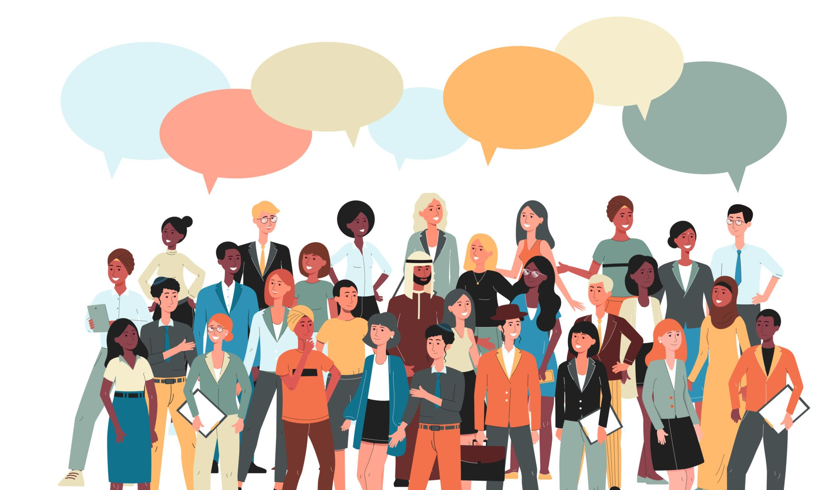
What do inequities look like in health experiences and outcomes?
From 2013 to 2021, people with a disability reported twice as high poverty rates.
(Campaign 2000, 2024)
US based study indicated 40.7% of doctors were confident in providing equal healthcare services
to disabled people.
(Health Affairs, 2021)
Roughly 1 in 5 Indigenous people report experiencing unfair treatment, racism, or discrimination in healthcare. (Stats Canada,2024)
Black women and people
with cervixes are 30% more likely to develop cervical cancer and 60% more likely to die from the condition than white counterparts.
(Cancer Medicine, 2024)
81% of trans and nonbinary individuals indicated having a primary doctor, but 45% reported having at least
1 unmet health need. (PULSE, 2020)
Notes:
While race and identity based data is not as robust as we need it to be in Canada, we have significant data capturing uneven experiences in health care access and outcomes for populations, including but not limited to those who identify as Indigenous, Black, and disabled. These highlight significant differences in experiences shaping the SDoH for equity deserving communities such as disabled and trans + non-binary individuals.

Slide 10

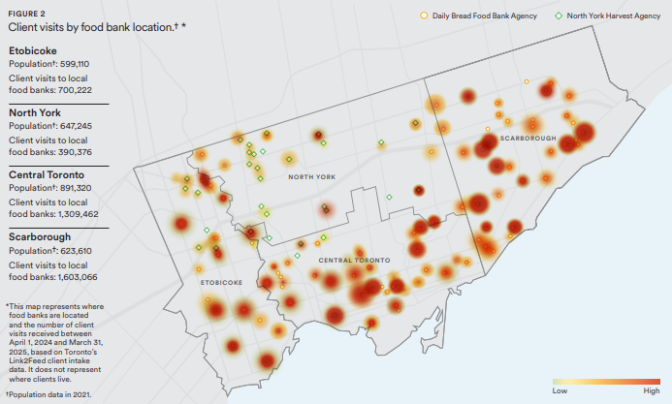
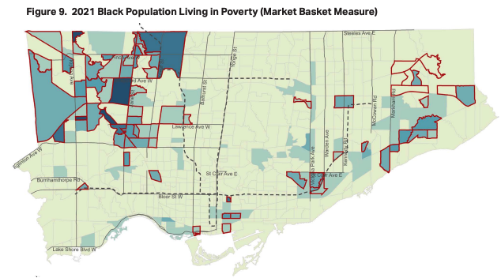


What do inequities look like in health experiences and outcomes?
Northwest Toronto neighbourhoods among those where Black populations are experiencing the highest levels of poverty in Toronto (Black Health Alliance, 2021)
Black workers in Canada received an average of less than ~$4/hour compared to non-visibly racialized individuals
(Stats Can, 2021)
14.4% of households in 2015 below poverty line, in comparison with 44% of Indigenous households
on reserve
(Canada Without Poverty, 2016)
Notes:
The examples on slide that demonstrate the deeply uneven health experiences and outcomes of equity deserving populations rooted in oppression:
81% of trans and non-binary individuals surveyed by PULSE indicated having a primary care doctor, but 45% reported having at least 1 unmet health need
Black women and people with cervixes in Canada are 30% more likely to develop cervical cancer and 60% more likely to die from the condition than white counterparts (Salami et al)
Roughly 1 in 5 Indigenous people report experiencing unfair treatment, racism, or discrimination in healthcare (Stats Canada)
Gaps in research related to impact of ableism in healthcare (this lack of inquiry also demonstrates ableism). US based study indicated 40.7% of doctors were confident in providing equal healthcare services to disabled people.
From 2013 to 2021, people with a disability reported twice as high poverty rates.
Also note limited access to race based data in Canada, and how this lack of investment in understanding our experiences is rooted in an erasure that equity deserving populations so often experience in Canada, as we commonly lean on conceptions of universality, multiculturalism, and Canadian exceptionalism
Importance of race based data, in community partnership, with ownership and guidance of communities and trust building

Slide 11

Post-Meeting Evaluation
We Value Your Feedback Please take 2 minutes to complete our brief post-meeting survey — your input helps us improve future sessions!
https://forms.office.com/r/q4U62LVX3J

Slide 12
Thank You

